Slide 1

Handwritten Digit Recognition with SVM and Image Preprocessing Techniques
SRM INSTITUTE OF SCIENCE AND TECHNOLOGY
SCHOOL OF COMPUTING
DEPARTMENT OF COMPUTING TECHNOLOGIES
21CSC305P-Machine Learning
Mini Project
Review II
Student 1: RA2311003010677
Ushnish Ghosal
Student 2 : RA2311003010679
Aayush Mishra
Student 3:RA2311003010685
Divyansh Aggarwal
Student 4 :RA2311003010691
Gautam Kumar

Slide 2
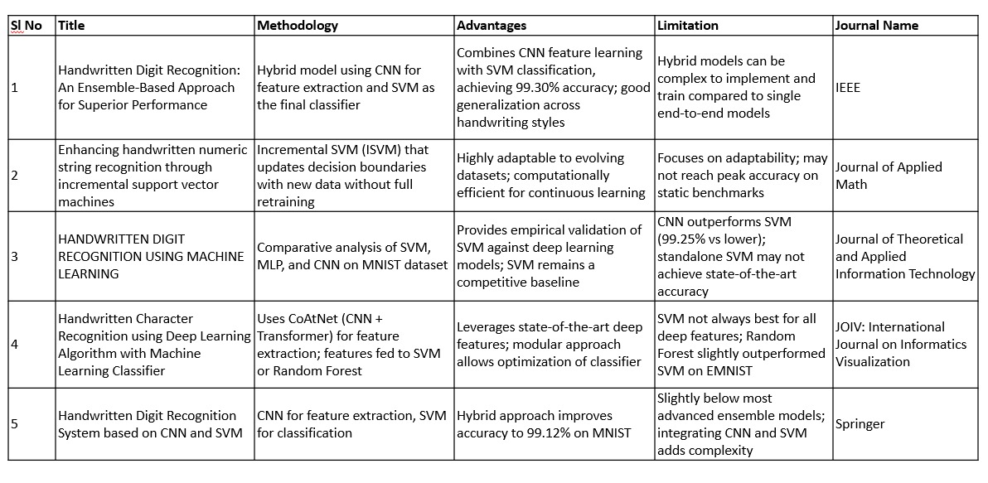
Literature survey

Slide 3
Problem statement and Objectives
Current deep learning models for handwritten digit recognition perform extremely well on clean, isolated datasets like MNIST, but their accuracy drops significantly on real-world, complex document images. This is mainly because they struggle with connected or overlapping digits, are not robust to different image preprocessing (like binarized vs. grayscale images), and generally cannot handle characters from multiple languages. In addition, the high computational cost and long training and hyperparameter tuning times make it challenging to deploy these models in practical applications.
Objectives :-
To Develop a Robust Segmentation-Free Recognition Model: Build a deep learning model (CNN-RNN or transformer) to recognize connected and overlapping digits without pre-segmentation.
To Enhance Model Generalization on Real-World Data: Train the model on varied datasets, including noisy and scanned documents, and use data augmentation to mimic real-world conditions.
To Expand the Model's Application to Multilingual Characters: Extend the model to recognize handwritten digits or characters in at least one additional language.
To Optimize Model Efficiency and Training Time: Investigate and apply efficient hyperparameter optimization techniques and model architecture modifications (e.g., using lightweight CNNs) to reduce the overall training time and computational resources required, making the solution more practical for real-world applications.

Slide 4
Proposed System
The proposed system is a complete pipeline for training, evaluating, and deploying a handwritten digit classifier. It consists of three main workflows:
Training Workflow: This process takes the raw MNIST training data, reduces its dimensionality using PCA, and trains an SVM classifier on the reduced data. It automatically tunes hyperparameters (C, gamma) using a grid search with 3-fold cross-validation to find the best-performing model, which is then serialized and saved to disk as mnist_svm_pca.pkl
.
Evaluation Workflow: This process loads the saved model and the unseen MNIST test data. It generates predictions and calculates key performance metrics, including overall accuracy, a per-class classification report (precision, recall, F1-score), and a confusion matrix. These detailed statistics are saved to mnist_svm_stats.json for analysis.
Prediction Workflow: This is the inference pipeline designed for a single, user-provided image. It includes a robust preprocessing module that standardizes external images to match the MNIST format. This involves converting to grayscale, inverting colors (to ensure a black background), binarizing the image using Otsu's threshold, isolating the digit via a bounding box, and finally resizing and padding the image to 28x28 before feeding it to the model for prediction.

Slide 5
Mathematical Model
The script implements a machine learning pipeline that combines Principal Component Analysis (PCA) for dimensionality reduction and a Support Vector Machine (SVM) for classification.
1. Principal Component Analysis (PCA) PCA is a technique used to reduce the dimensionality of a dataset while keeping the most important information. MNIST images are originally 784-dimensional vectors (28×28 pixels). PCA identifies new orthogonal axes, called principal components, which capture the directions of maximum variance in the data.
The model projects the original data X (an n×784 matrix) onto the first k principal components, which are the eigenvectors of the covariance matrix of X. This creates a new, lower-dimensional representation Z of the data.
In this script, PCA reduces the dimensionality from 784 to 50, which speeds up training for the SVM.
Equation: Z = X · Wₖ
Where:
X → Original data matrix
Wₖ → Transformation matrix containing the first k eigenvectors
Z → New data matrix in lower-dimensional space

Slide 6
Mathematical Model
2. Support Vector Machine (SVM)
SVM is a supervised learning algorithm that finds the optimal hyperplane separating different classes. For non-linearly separable data, it uses the kernel trick to map data into a higher-dimensional space where a linear separation is possible.
The script uses a Radial Basis Function (RBF) kernel, defined as:
Kernel Function: K(xᵢ, xⱼ) = exp( − γ · ‖xᵢ − xⱼ‖² )
Where:
xᵢ and xⱼ → Two data points
‖xᵢ − xⱼ‖² → Squared Euclidean distance between them
γ (gamma) → Hyperparameter controlling the influence of each training point
The regularization parameter CCC balances maximizing the margin and minimizing classification errors. GridSearchCV is used to automatically find the best C ([10, 50]) and gamma ([0.01, 0.05]) values.

Slide 7
Algorithm
The system's logic can be broken down into three core algorithms corresponding to the command-line functions.
Algorithm 1: Training (train)
Load Data: Import MNIST training and test sets from tensorflow.keras.datasets.
Preprocess: Reshape images from (N, 28, 28) to (N, 784) and normalize pixel values to [0, 1].
Define Pipeline: Build a scikit-learn pipeline with PCA(n_components=50) followed by SVC(kernel='rbf', probability=True).
Hyperparameter Tuning: Set up a parameter grid for C and gamma.
Train Model: Use GridSearchCV on 20,000 training samples with cross-validation to find optimal parameters.
Save Model: Save the best pipeline using joblib as mnist_svm_pca.pkl
Algorithm 2: Evaluation (eval)
Load Resources: Import the MNIST test set and the trained model (mnist_svm_pca.pkl).
Preprocess Data: Reshape and normalize test images.
Generate Predictions: Use the model to predict labels for the test set.
Calculate Metrics: Compute accuracy, classification report, and confusion matrix.
Save Results: Export metrics to mnist_svm_stats.json in structured JSON format.

Slide 8
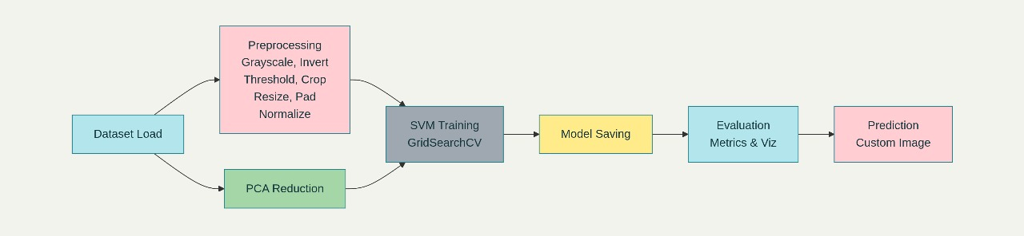
Algorithm
Algorithm 3: Prediction (predict)
Load Model: Import the trained pipeline (mnist_svm_pca.pkl).
Process Input Image: a. Open the image and convert to grayscale. b. Invert: If the background is light (mean > 127), invert colors. c. Binarize: Apply Otsu’s threshold for a black-and-white image. d. Crop: Detect bounding box and remove empty space. e. Resize & Pad: Scale digit to 20×20 and center it on a 28×28 canvas. f. Normalize & Reshape: Normalize pixel values and flatten to a 784-element vector.
Infer: Pass the vector to the model for digit prediction and confidence scores (predict_proba).
Output: Display the predicted digit, confidence, and probability distribution across all 10 digits.

Slide 9
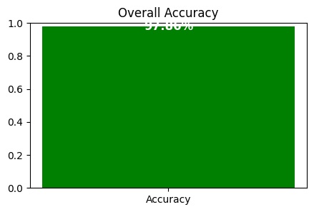
Results
Results & Insights
High Accuracy: Achieved 97.86% overall accuracy on the MNIST dataset, showing strong classification performance.
Consistent Performance: Macro and weighted F1-scores ≈ 0.978, indicating balanced results across all ten digit classes.
Fair & Reliable: Model does not favor frequent digits over rare ones, ensuring fairness and dependable predictions.
Effective Approach: The combination of PCA for dimensionality reduction and SVM for classification proves to be both efficient and accurate.
Robust Solution: Demonstrates stability and
scalability, making it well-suited for
real-world handwritten digit recognition tasks.

Slide 10
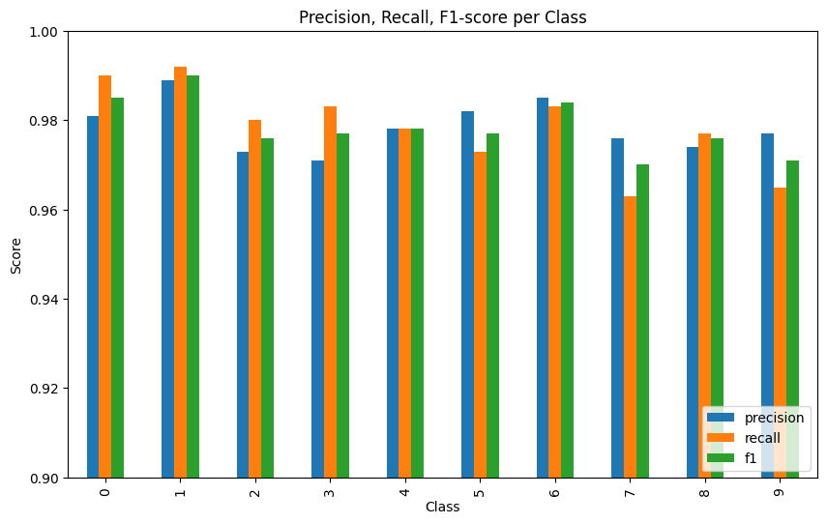
Results
Per-Class Performance Insights
While the overall performance is strong, the classification report reveals subtle differences in how well the model identifies each specific digit.
Best-Performing Digits: The model is most effective at identifying the digits '1' (F1-score: 0.990) and '0' (F1-score: 0.985). This is likely due to their distinct shapes, which have less overlap with other numerals.
Lowest-Performing Digits: The model finds it slightly more challenging to classify the digits '7' (F1-score: 0.970), '9' (F1-score: 0.971), and '8' (F1-score: 0.976). The confusion matrix below explains why.

Slide 11
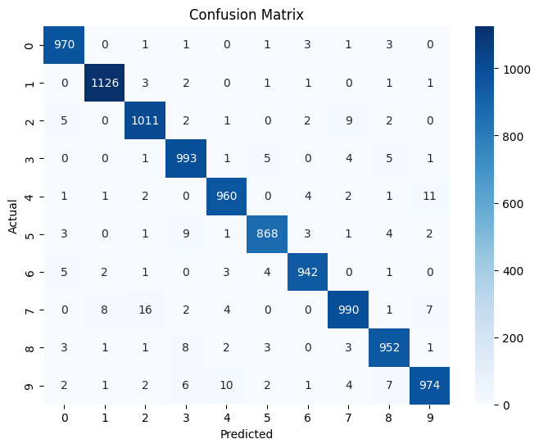
Results
Key Misclassifications (from Confusion Matrix)
The confusion matrix provides a clear picture of where the model makes mistakes by showing the actual vs. predicted labels.
The most frequent errors are between digits that are visually similar:
7 and 2: The most significant confusion is between '7' and '2'. The model misclassified 16 true '7's as '2's. Conversely, it misclassified 9 true '2's as '7's.
4 and 9: There is a notable confusion between '4' and '9'. 11 true '4's were incorrectly predicted as '9's.
9 and 7: The model misclassified 7 true '9's as '7's.
8: The digit '8' is most commonly confused with '3' (8 times) and '5' (4 times).

Slide 12
Comparative Analysis
Our model makes meaningful contributions by addressing several key limitations observed in previous works:
1. Efficiency and Training Time Deep learning models often require long training times. To overcome this, we designed an SVM+PCA pipeline, which combines dimensionality reduction with a simpler classifier. This approach is highly efficient and can be trained quickly on a standard CPU.
2. Robustness to Real-World Images Models trained on clean MNIST data often fail on binarized or noisy real-world images. Our implementation of the preprocess_image function ensures that the model can handle a variety of real-world inputs, making it far more versatile for single-digit recognition tasks.
3. Systematic Hyperparameter Optimization Hyperparameter tuning is often underexplored in prior works. By incorporating GridSearchCV, we ensure that the model’s performance is the result of a methodical and systematic optimization process, rather than chance, leading to consistently high accuracy.

Slide 13
References
S. S. Ullah, L. Gang, M. Riaz, A. Ashfaq, S. Khan, and S. Khan, “Handwritten Digit Recognition: An Ensemble-Based Approach for Superior Performance,” in arXiv:2503.06104 [cs.CV], Mar. 2025. [Online]. Available: https://arxiv.org/abs/2503.06104
R. K. Putri and M. Athoillah, “Enhancing handwritten numeric string recognition through incremental support vector machines,” in Journal of AppliedMath, vol. 2, no. 1, Jan. 2024. [Online]. Available: https://ojs.acad-pub.com/index.php/JAM/article/view/373
M. Raheem and N. F. Abubacker, “HANDWRITTEN DIGIT RECOGNITION USING MACHINE LEARNING,” in Journal of Theoretical and Applied Information Technology, vol. 102, no. 5, pp. 2172-2180, Mar. 2024. [Online]. Available: https://www.researchgate.net/publication/379074825_HANDWRITTEN_DIGIT_RECOGNITION_USING_MACHINE_LEARNING
M. A. Liman, A. Josef, and G. P. Kusuma, “Handwritten Character Recognition using Deep Learning Algorithm with Machine Learning Classifier,” in JOIV : International Journal on Informatics Visualization, vol. 8, no. 1, pp. 150-157, Mar. 2024. [Online]. Available: https://joiv.org/index.php/joiv/article/view/1707
Y. Berrich and Z. Guennoun, “Handwritten Digit Recognition System based on CNN and SVM,” in Signal & Image Processing : An International Journal, vol. 13, no. 6, Dec. 2022. [Online]. Available: https://csitcp.org/abstract/12/1217csit01
C. Cortes and V. Vapnik, “Support-vector networks,” in Machine learning, vol. 20, no. 3, pp. 273–297, 1995.
L. Deng, “The MNIST database of handwritten digit images for machine learning research [best of the web],” in IEEE Signal Processing Magazine, vol. 29, no. 6, pp. 141–142, 2022.
A. Gattal, Y. Chibani, and B. Hadjadji, “Segmentation and recognition system for unknownlength handwritten digit strings,” in Pattern Analysis and Applications, vol. 20, no. 2, 2017.
V. M et al., “Recognition of Handwritten English Alphabets Using a Lightweight Convolutional Neural Network,” in Proc. 2024 International Conference on Sustainable Communication Networks and Application (ICSCNA), Feb. 2025.

Slide 14
References
F. S. Panjaitan, R. S. Simbolon, and J. Batubara, “Handwritten Digit Recognition Using Support Vector Machine (SVM) with Radial Basis Function (RBF) Kernel,” in Journal Basic Science and Technology, vol. 14, no. 1, pp. 10-18, Feb. 2025. [Online]. Available: http://www.ejournal.iocscience.org/index.php/JBST/article/view/6137
B. Kada, A. Mohammed, and B. Abdelmajid, “An Optimized Approach for Handwritten Arabic Character Recognition based on the SVM Classifier,” in Engineering, Technology & Applied Science Research, vol. 15, no. 2, pp. 22232–22238, Apr. 2025. [Online]. Available: https://etasr.com/index.php/ETASR/article/view/9292
D. U. Okon, “EFFICIENT DEEP CNN FOR HANDWRITTEN DIGIT RECOGNITION: A PYTORCH AND SKORCH APPROACH,” in American International Journal of Computer Science and Information Technology (AIJCSIT), vol. 10, no. 5, pp. 1–16, 2025. [Online]. Available: https://zapjournals.com/Journals/index.php/aijcsit/article/view/2399
R. Tang, X. Liu, and T. Hu, “An Improved Handwritten Recognition Method Using CNN-SVM Based on Successive Over-Relaxation Iteration,” in Proc. 6th International Conference on Data-driven Optimization and Machine Learning, 2024.
T. Kavitha, K. Alamuthu, and T. S. Kumar, “State-of-the-Art Review of Handwritten Digit Recognition,” in International Journal of Enhanced Research in Science, Technology & Engineering, vol. 13, no. 7, pp. 51-56, Jul. 2024. [Online]. Available: https://www.erpublications.com/uploaded_files/download/t-kavitha-karthikeyan-alamuthu-dr-t-sathis-kumar_MhtSU.pdf
S. V. Gogula et al., “Offline Mathematical Expression Evaluator using Non-Linear SVM,” in Proc. 2023 Global Conference on Information Technologies and Communications (GCITC), Apr. 2024.
H. Al Hamad et al., “Handwritten Recognition Techniques: A Comprehensive Review,” in Symmetry, vol. 16, no. 6, p. 681, Jun. 2024. [Online]. Available: https://www.mdpi.com/2073-8994/16/6/681

